Slide 1


Notes:
An animated girl with long purple hair, in the Japanese anime art style, writing something in her room after recovering, with a more serious face.

Slide 2
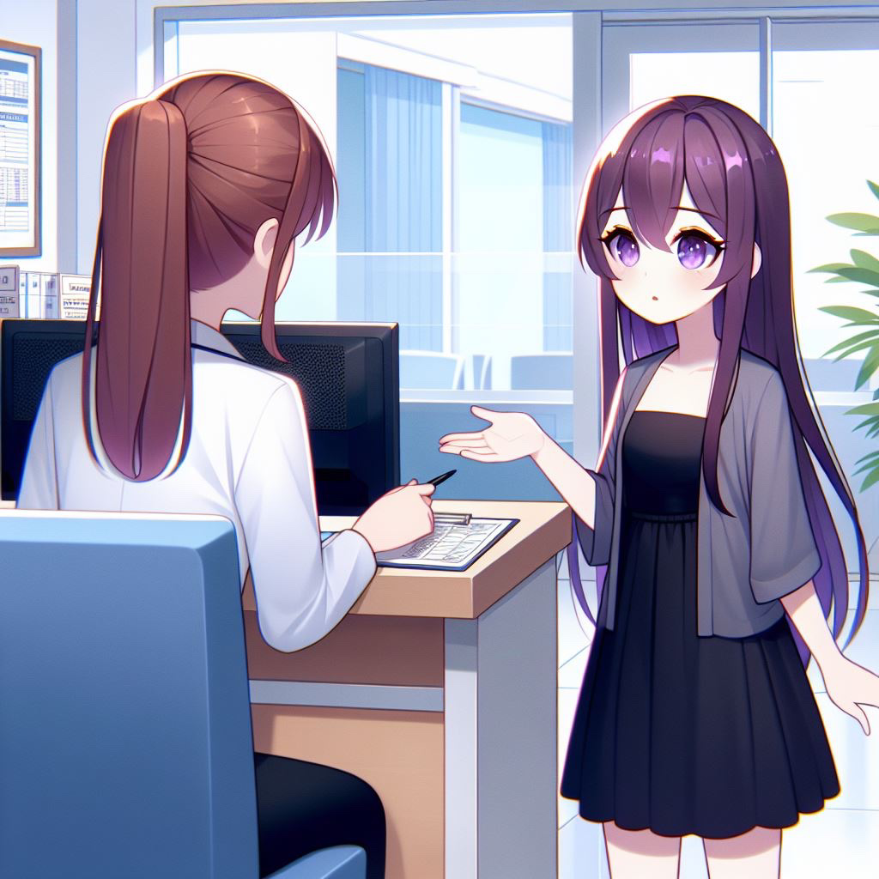

Notes:
An animated girl with long purple hair, in the Japanese anime art style, asking something at the hospital counter, wearing a black dress.

Slide 3
Notes:
An animated girl with long purple hair, in the Japanese anime art style, asking something at the hospital counter, wearing a black dress.

Slide 4
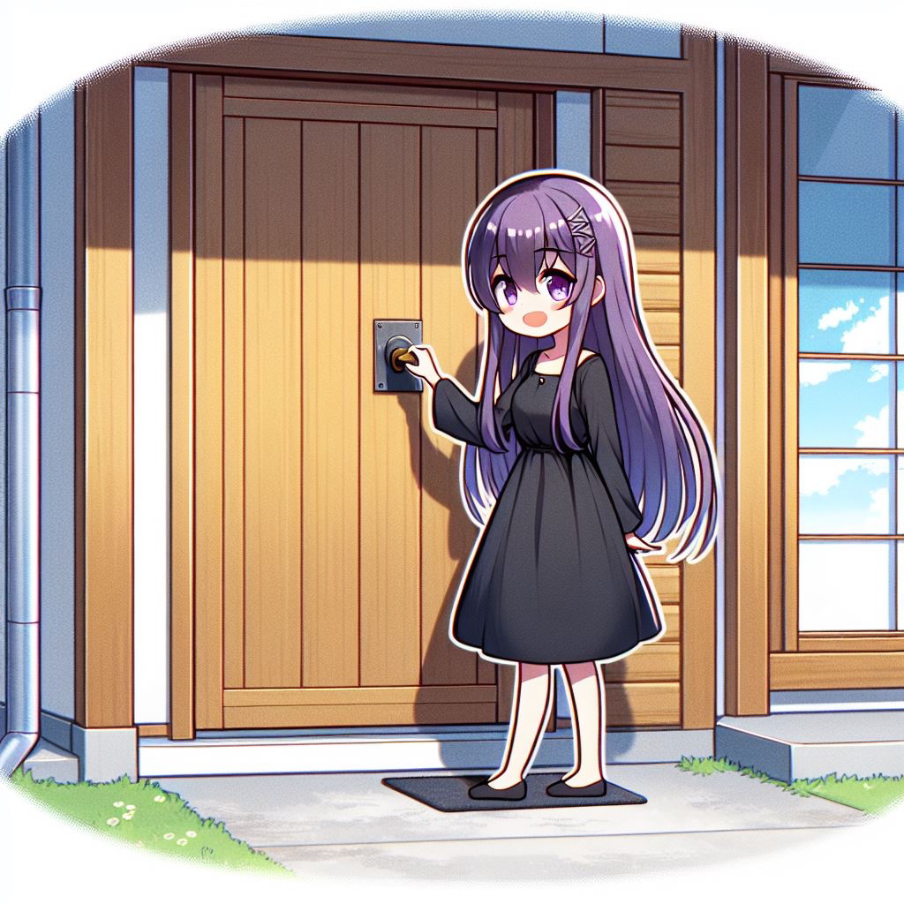
?
Notes:
An animated girl with long purple hair, in the Japanese anime art style, asking something at the hospital counter, wearing a black dress.

Slide 5

Notes:
An animated girl with long purple hair, in the Japanese anime art style, standing outside the house in front of a closed door, knocking on it, wearing a black dress.

Slide 6
Notes:
An animated girl with long purple hair, in the Japanese anime art style, standing outside the house in front of a closed door, knocking on it, wearing a black dress.

Slide 7
Notes:
An animated girl with long purple hair, in the Japanese anime art style, standing outside the house in front of a closed door, knocking on it, wearing a black dress.

Slide 8



Notes:
An animated girl with long purple hair, in the Japanese anime art style, standing outside the house in front of a closed door, knocking on it, wearing a black dress, and she found a purple bat plushie on the ground.

Slide 9
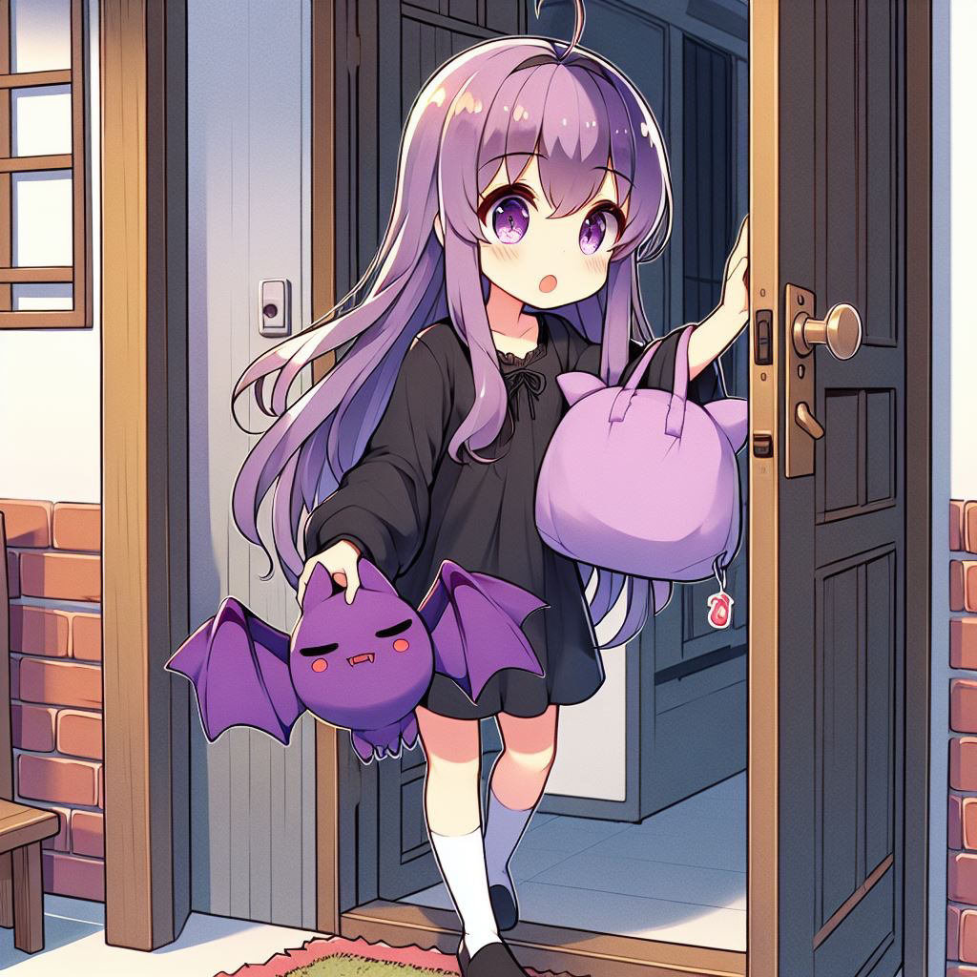
Notes:
An animated girl with long purple hair, in the Japanese anime art style, standing outside the house in front of a closed door, knocking on it, wearing a black dress, and she found a purple bat plushie on the ground.

Slide 10

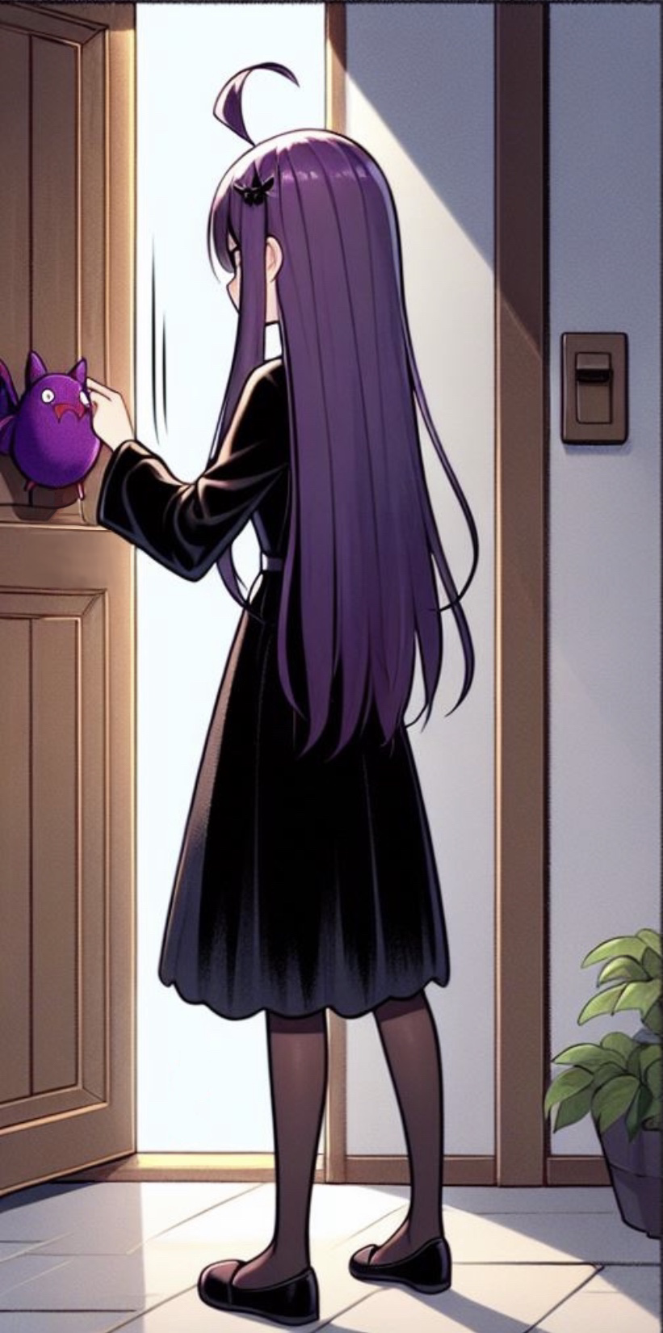
Notes:
An animated girl with long purple hair, in the Japanese anime art style, standing outside the house in front of a closed door, knocking on it, wearing a black dress, and she found a purple bat plushie on the ground, and she takes the plushie home, and accidentally got a little drop of the red liquid on the bat plushie from her hand, in the Japanese anime art style.

Slide 11


Notes:
An animated girl with long purple hair, in the Japanese anime art style, standing outside the house in front of a closed door, knocking on it, wearing a black dress, and she found a purple bat plushie on the ground, and she takes the plushie home, and accidentally got a little drop of the red liquid on the bat plushie from her hand, in the Japanese anime art style, with the red liquid, and the bat plushie became alive and talk to the girl that it can bring her to a mysterious market.

Slide 12
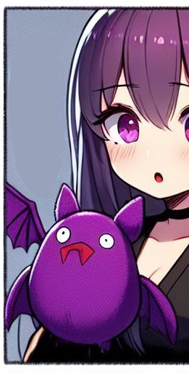

Notes:
An animated girl with long purple hair, in the Japanese anime art style, standing outside the house in front of a closed door, knocking on it, wearing a black dress, and she found a purple bat plushie on the ground, and she takes the plushie home, and accidentally got a little drop of the red liquid on the bat plushie from her hand, in the Japanese anime art style, with the red liquid, and the bat plushie became alive and talk to the girl that it can bring her to a mysterious market.

Slide 13
Notes:
An animated girl with long purple hair, in the Japanese anime art style, standing outside the house in front of a closed door, knocking on it, wearing a black dress, and she found a purple bat plushie on the ground, and she takes the plushie home, and accidentally got a little drop of the red liquid on the bat plushie from her hand, in the Japanese anime art style, with the red liquid, and the bat plushie became alive and talk to the girl that it can bring her to a mysterious market.

Slide 14
Notes:
An animated girl with long purple hair, in the Japanese anime art style, standing outside the house in front of a closed door, knocking on it, wearing a black dress, and she found a purple bat plushie on the ground, and she takes the plushie home, and accidentally got a little drop of the red liquid on the bat plushie from her hand, in the Japanese anime art style, with the red liquid, and the bat plushie became alive and talk to the girl that it can bring her to a mysterious market.

Slide 15
Notes:
An animated girl with long purple hair, in the Japanese anime art style, standing outside the house in front of a closed door, knocking on it, wearing a black dress, and she found a purple bat plushie on the ground, and she takes the plushie home, and accidentally got a little drop of the red liquid on the bat plushie from her hand, in the Japanese anime art style, with the red liquid, and the bat plushie became alive and talk to the girl that it can bring her to a mysterious market.

Slide 16
Notes:
An animated girl with long purple hair, in the Japanese anime art style, standing outside the house in front of a closed door, knocking on it, wearing a black dress, and she found a purple bat plushie on the ground, and she takes the plushie home, and accidentally got a little drop of the red liquid on the bat plushie from her hand, in the Japanese anime art style, with the red liquid, and the bat plushie became alive and talk to the girl that it can bring her to a mysterious market.

Slide 17


Notes:
An animated girl with long purple hair, in the Japanese anime art style, standing outside the house in front of a closed door, knocking on it, wearing a black dress, and she found a purple bat plushie on the ground, and she takes the plushie home, and accidentally got a little drop of the red liquid on the bat plushie from her hand, in the Japanese anime art style, with the red liquid, and the bat plushie became alive and talk to the girl that it can bring her to a mysterious market.

Slide 18

Notes:
An animated girl with long purple hair, in the Japanese anime art style, standing outside the house in front of a closed door, knocking on it, wearing a black dress, and she found a purple bat plushie on the ground, and she takes the plushie home, and accidentally got a little drop of the red liquid on the bat plushie from her hand, in the Japanese anime art style, with the red liquid, and the bat plushie became alive and talk to the girl that it can bring her to a mysterious market.

Slide 19
Notes:
An animated girl with long purple hair, in the Japanese anime art style, standing outside the house in front of a closed door, knocking on it, wearing a black dress, and she found a purple bat plushie on the ground, and she takes the plushie home, and accidentally got a little drop of the red liquid on the bat plushie from her hand, in the Japanese anime art style, with the red liquid, and the bat plushie became alive and talk to the girl that it can bring her to a mysterious market.

